Slide 1
Module 3: Cold Climate Adaptation

Slide 2
Hydroponics: Growing Media 101

Slide 3
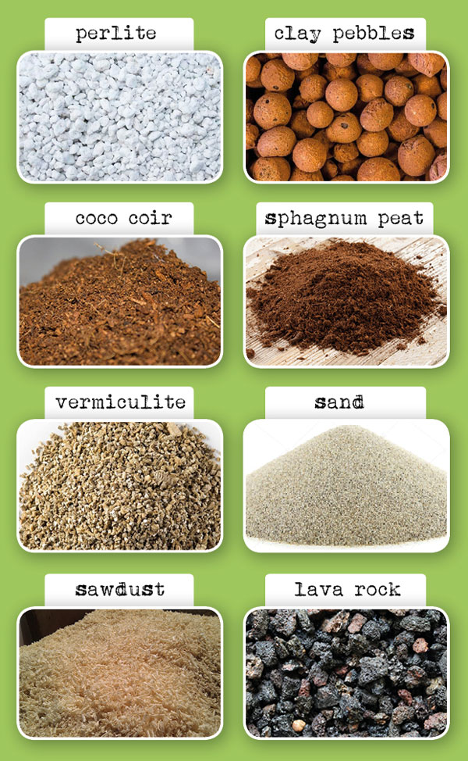
Hydroponics: Growing Media 101 Key Notes
Different materials perform better in aeration, water absorption, and cation exchange
They essentially just hold the plant in place without necessarily providing nutrients
Media that absorb more water are hard to use as they are possible to over water

Slide 4
Hydroponics Systems side-by-side - Aeroponics vs Drip, Kratky and DWC

Slide 5
Hydroponics Systems side-by-side - Aeroponics vs Drip, Kratky and DWC Key Points
Gives an experimental comparison between the yields of different hydroponics systems with soil as a control:
Kratky (still water with nutrients)
Drip (water is dripped to the plant roots)
Deep water culture (deep reservoir that is aerated with water)
Aeroponics (water is misted up to the roots)
All tubs have opaque top to not let light in which would cause algae growth
They all performed differently, aeroponics and Kratky had the best fruit yields
Water temps varied from within the room

Slide 6
How To Clean Out The Idoo Hydroponic System

Slide 7
How To Clean Out The iDoo Hydroponic System Key Notes
Use a towel to clean off the light/top
Plants can briefly be left on a towel
Filter has to be cleaned out, rinse out the sponge in the sink, mostly removing root bits
Dump the water out of the unit
Pull roots out of the unit
Refill water
Clean monthly
Make sure not to get water in the electrical area
Let the pump run to circulate water prior to readding plants
Tin foil can reflect light back at the plants

Slide 8
Common Raised Garden Bed Mistakes (To Avoid)

Slide 9
Common Raised Garden Bed Mistakes (To Avoid) Key Notes
Do not make the bed too large, make sure you can reach all sides
Place them in the right location, needs sun and water
Correct spacing between beds, enough room to move through with something like a wheelbarrow
Use the right kind of soil, native soil might be lacking in nutrients
Wood beds decompose, particularly in hot/humid areas, there are alternatives that allow the garden to be more permanent
Continue regularly adding organic components like compost
Have an irrigation plan, potentially prior to the construction of the bed
Cover pathways to prevent weeds between beds
Take advantage of hoops over the raised beds to protect plants from frost

Slide 10
Common Raised Garden Bed Mistakes (To Avoid) Notes
Do not make the bed too ________ make sure you can reach all sides
Place them in the right location, needs ________ and ________
Correct spacing between beds, enough room to move through with something like a wheelbarrow
Use the right kind of soil, native soil might be lacking in nutrients
Wood beds decompose, particularly in hot/humid areas, there are alternatives that allow the garden to be more permanent
Continue regularly adding organic components like compost
Have an irrigation plan, potentially prior to the construction of the bed
Cover pathways to ________ ________ between beds
Take advantage of hoops over the raised beds to protect plants from frost

Slide 11
Garden Time Lapse - Start to Finish

Slide 12
Still need to make video on:
Nutrient preparation
How to set up the chosen kit?

Slide 13
Guide Sheets

Slide 14
Hydroponic Guide Sheet
Background
Hydroponics is a way to skip the soil and grow crops directly in nutrient-rich water.
Roots are submerged in an inorganic medium then apply nutrient rich water
Examples of inorganic mediums are vermiculite, pearlite, rockwool or expanded clay substrate
Types
There are six main types of hydroponic systems to choose from:
Wick Systems
Deep Water Culture (DWC)
Nutrient Film Technique (NFT).
Ebb and Flow (Flood and Drain)
Aeroponics
Drip Systems
Kratky Method
Benefits
Reduces the amount of water required for plants
Reduces issues that many soil-based greenhouses experience such as bacteria growth, mould and pests
Massively increases growth rate of most plants
Increases production yield
Important of pH Level
The best pH for hydroponics is a slightly acidic range of 5.5-6.5. However, it does vary from plant to plant
Availability of nutrients vary with pH

Slide 15
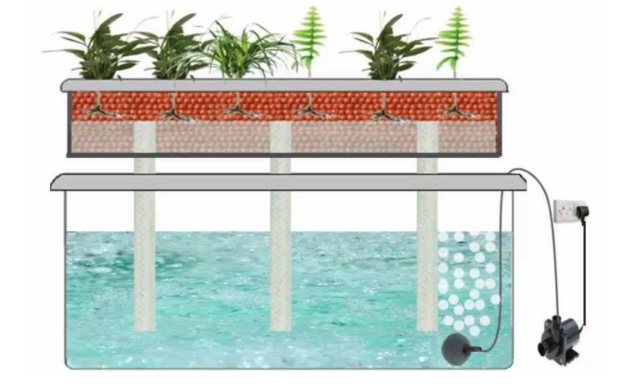
Wick System
Background
Also known as passive hydroponics
Do not need air pump or water pump
Nutrients and water are moved into a plant’s root zone via a wick, which is often something as simple as a rope or piece of felt.
Key to success in this system is the medium
Good choices include coconut coir, perlite, or vermiculite
Pros
Good for smaller plants
Truly “hands off” if set it up correctly
Good for children and beginner
Cons
Larger plants may have problem with getting enough nutrients and water
Incorrect wick placement or material can mean death for your plants

Slide 16
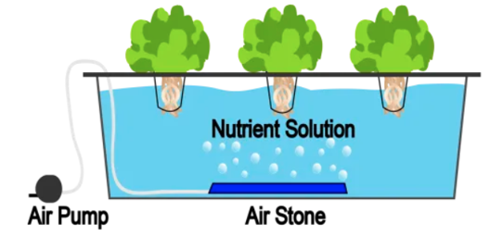
Deep Water Culture (DWC) System
Background
Use reservoir to hold nutrient
The roots of the plants are suspended in that solution, so they get a constant supply of water, oxygen, and nutrients.
To oxygenate the water, use an air pump with an air stone to pump bubbles into the nutrient solution. This prevents roots from drowning in the water
Plants are typically housed in net pots that are placed in a foam board or into the top of the container
Pros
Very inexpensive and easy to make at home
Extremely low maintenance
Recirculating, so less wasted inputs
Cons
Does not work well for large plants
Does not work well for plants with long growing period

Slide 17
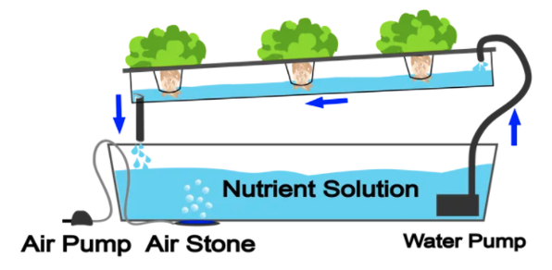
Nutrient Film Technique (NFT) System
Background
Is a popular hydroponic system
Plants are grown in channels that have a nutrient solution pumping through them and constantly running along the bottom of the channel.
When the solution reaches the end of the channel, it drops back into a main reservoir and is sent back to the beginning of the system again. This makes it a recirculating system, just like deep water culture.
Unlike deep water culture, plants roots are not completely submerged
Plants are placed in these channels using net pots and growing medium and can be replaced or harvested on a one-by-one basis.
Pros
Minimal growing medium needed
Recirculating system means less waste
Cons
Pump failure of any kind can completely ruin the crop
Roots can become overgrown and clog the channels
Would required pre-germination of seeds

Slide 18
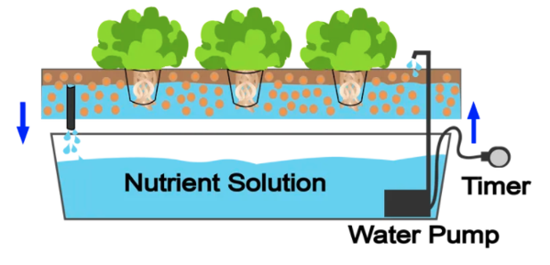
Ebb and Flow (Flood and Drain) System
Background
The tray is “flooded” with your nutrient solution a few times per day, depending on factors like:
The size of the plants
The water requirement of your plants
The air temperature
Where the plants are in their growth cycle
Accomplished by using a reservoir below the tray, a water pump, and a timer to schedule the flooding cycle.
After the tray is flooded, gravity drains the solution back down into the reservoir, where it is being oxygenated by an air pump and air stone. It sits there waiting for the next flood cycle, and the process goes on.
Pros
Efficient use of water and energy
Highly customizable and flexible
Cons
Roots can dry out quickly if environmental conditions are off or the pump or timer fails
Uses a lot of growing mediums

Slide 19
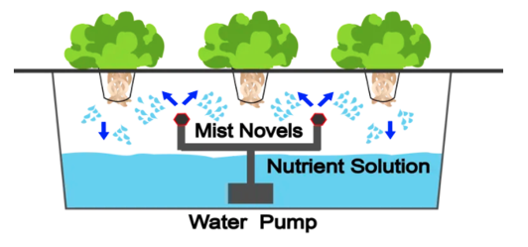
Aeroponics System
Background
Roots are mostly suspended in air
Achieves this by misting the root zone with a nutrient solution constantly instead of running a thin film of nutrient solution along a channel
Mist on a cycle like an ebb and flow system, but the cycle is much shorter, typically only waiting a few minutes between each misting.
Also possible to mist on a continual basis and use a finer sprayer to ensure more oxygen gets to the root zone
Pros
Roots often are exposed to more oxygen than submerged-root systems
High-pressure nozzles can fail and roots can dry out
Cons
Not as cheap or easy to set up as other methods
Would required pre-germination of seeds

Slide 20
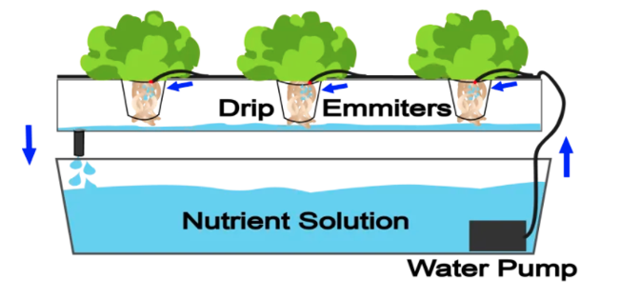
Drip System
Background
Extremely common in commercial operations, but less common in recreational gardens.
Water is pumped in tubing that can end at a single plant or can branch off with several tubes ending at many plants
Usually set on a timer
Nutrient rich water flows over the grow medium and drips down over the plant roots
Can be set up as either recover or a non drip recovery method
Non recovery systems
Nutrient water that runs over the plant’s roots does not go back into a reservoir
It’s only used once
Recovery systems
Reuse the nutrient solution after it is dripped over the roots
More efficient in saving money, water and nutrient solution
Pros
High level of control over feeding and watering schedule
Less likely to break
Relatively cheap
Cons
May be overkill for a smaller garden
Fluctuating pH and nutrient levels (if using recirculating system)
High waste (if using waste system)

Slide 21
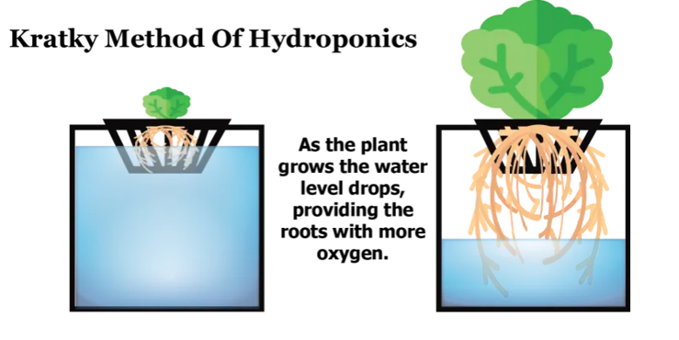
Kratky Method
Background
Entirely passive
No pumps required
The nutrient solution remains stagnant
As the plants drink from their small reservoir and the water level drops, an air gap grows between the nutrient solution and the plant itself, allowing the plant to breathe without oxygenating the reservoir.
When more water is added into the reservoir, it is important to leave an unfilled area open for the roots to breathe
Works better indoor or in a greenhouse or covered area
Pros
No electricity needed
Minimal maintenance
Minimal cost
Cons
Harder to control when the system is outdoor due to rain water may flood the system and dilute nutrient solution
Larger plant grows slower
May have pests problem due to stagnant water
Need quality water to start (be aware of the salt and the pH)
Harder to control temperature

Slide 22
Planting Schedule
For Thunder Bay: https://www.almanac.com/gardening/planting-calendar/on/Thunder%20Bay
For Other Regions In Ontario: https://www.almanac.com/gardening/planting-calendar/on

Slide 23
Plants Medium Guide Sheet
What Makes A Great Growing Medium
Is organic, biodegradable and environmentally friendly
Keeps an even ratio of air to water
Has capacity to hold nutrients
Helps protect plants from pH changes over time
Is inexpensive and easy to find
Is lightweight enough and easy to carry around
Types
Pearlite
Coconut Coir
Vermiculite
Rockwool
Expanded Clay Pellets or Leca
Oasis Cubes
Rice Hulls
Pumice
Growstones
Sawdust
Wood Chips/ Fibers
Peat Moss
Sand
Gravel
Soil

Slide 24
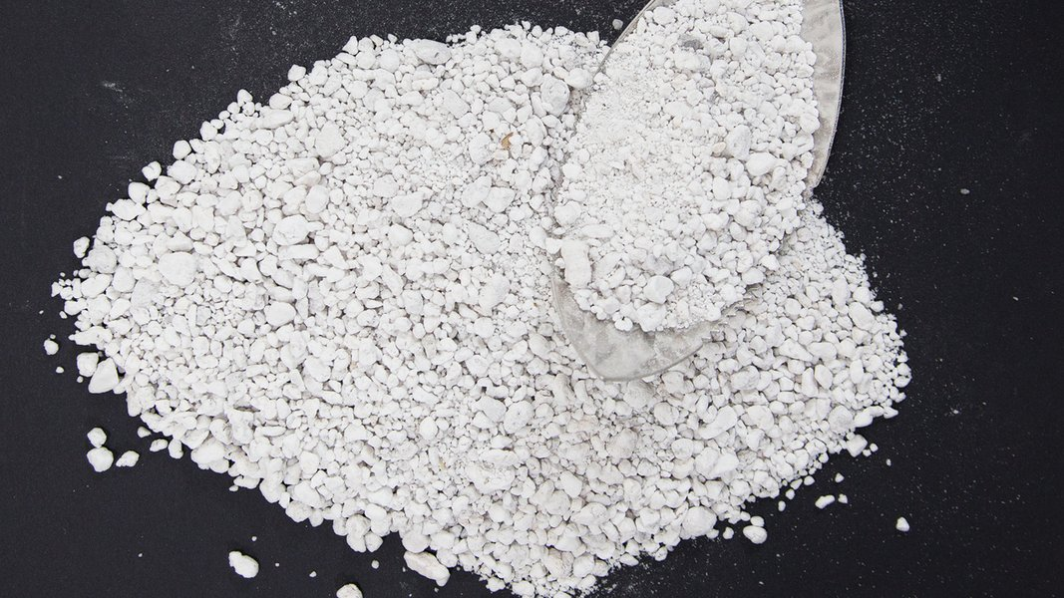
Pearlite
Background
Is created under intense and rapid heat
Is very lightweight and porous
Tend to float on water which can be washed away fast and easily by flowing water
Good for Wick System but bad for EBB and Flow System
Can be used in Drips system and Aeroponics system
Able to hold air very well and having neutral pH
Is rarely used alone, often mix it with other growing media like vermiculite, coco coir or soil
Pros
Reasonably inexpensive
Lightweight
High air retention.
Reusable
Cons
Lightweight, not suitable for certain system kinds.
Dust effects on the environment and health

Slide 25
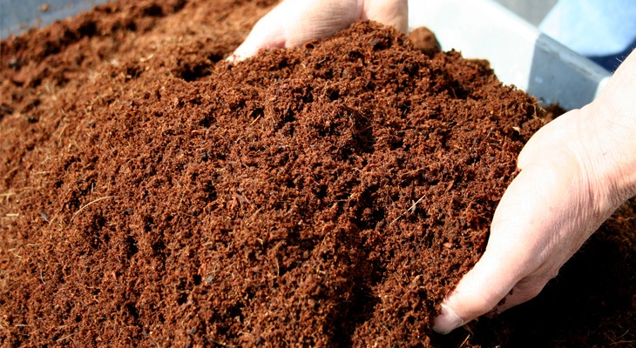
Coconut Coir
Background
Is a by-product of the coconut industry. Made from the brown husks surrounding the coconut shell
Is organic, highly inert, and holds water very well
Has really good air to water ratio
Is environmentally friendly and renewable
Can be used alone or mixed with other growing media
Can be used in Drip system and Ebb and flow system
Pros
Excellent water retention and aeration
Organic material
Environmentally friendly
Cons
Uncompressed after several uses.
Does not drain well, so often mixed with other media.

Slide 26
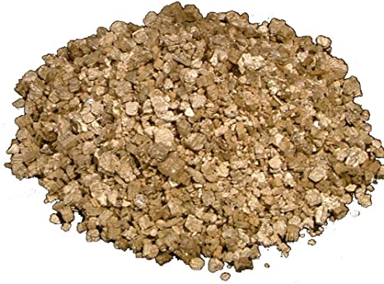
Vermiculite
Background
Is a form of hydrated laminar minerals
Processed by exposing the material to extreme heat to expand them into small clean, odorless pellets
Is non-toxic, sterile, moist-resistant and has a nearly neutral pH
Is very lightweight and able to hold water very well
Has reasonably great capacity to hold nutrients
Can be used in the Drip system and Aeroponic system
Pros
Good water and nutrient retention
Cons
Poor drainage capacity
Danger of suffocating plants

Slide 27
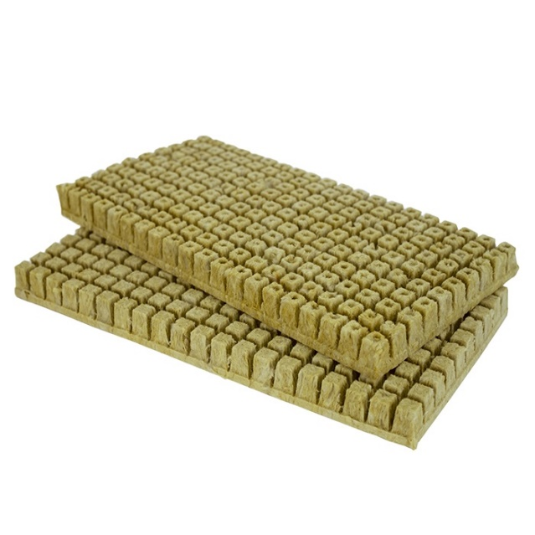
Rockwool
Background
Is primarily made up of granite and/or limestone rocks which are heated until melting and then are spun into super thin and long fibers. Then, these fibers are compressed into cubes, bricks of preferred sizes
The natural pH of the material is usually high, which can alter the nutrient solution pH. This can be prevented by soaking this media into pH balanced water before using
The dust giving off from it can cause irritation and is not good for the lungs and eyes
Can be used in Drip system, Ebb and flow system, Deep water cultures system, Nutrient-film technique system
Pros
Excellent water retention and aeration
Organic material
Environmentally friendly
Cons
Not environmentally friendly
The dust is not good for the health.
Disturb the pH of the nutrient solution
Is non-degradable and not sustainable

Slide 28
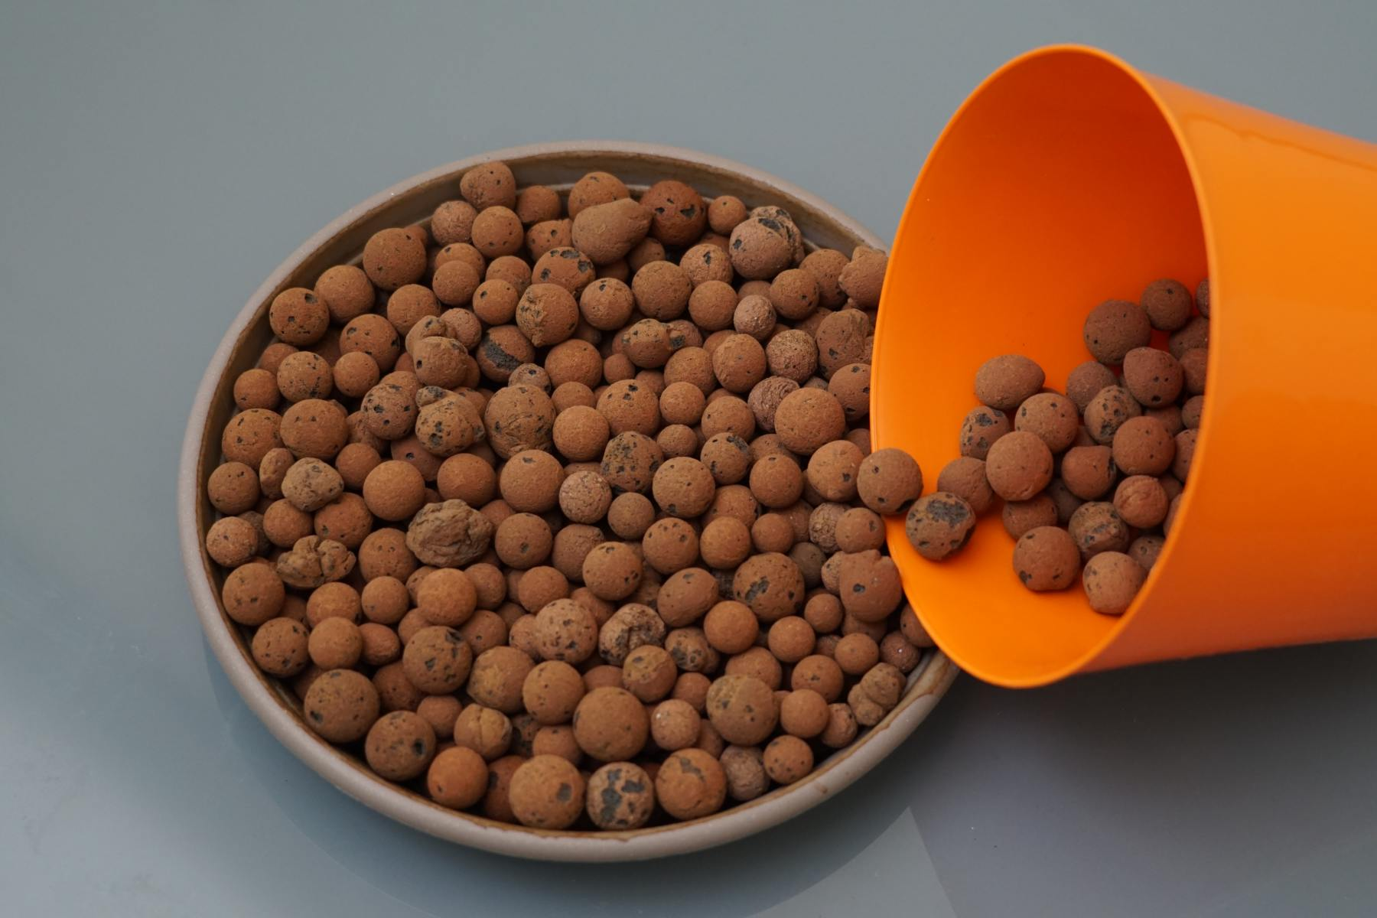
Expanded Clay Pellets or Leca
Background
Is created by heating and expanding clays to form thousands of small bubble-shaped balls
Is lightweight and reusable
Has good balanced water to oxygen and neutral pH
Is not a good water holding material
Is heavier and more expensive than other media
Can be used in Drip systems, Ebb and flow systems
Pros
Reusable, sustainable.
Effective water drainage, and air retention
Cons
Poor moisture retention capacity
More expensive than other growing media

Slide 29
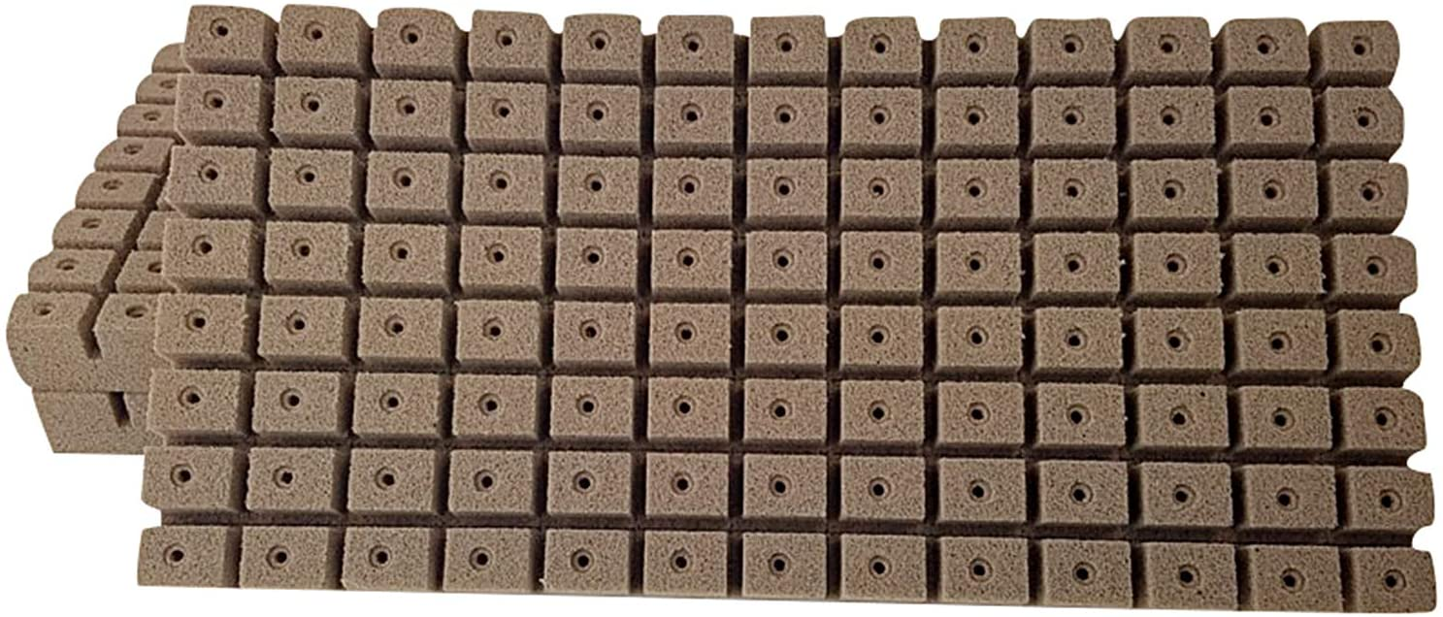
Oasis Cubes
Background
Is made from floral foam
Contains the right amount of nutrients as well as air and water for plants’ growing
Use primarily as a starting environment for seedlings or plants’ cuttings, not as a full growing medium
Has neutral pH
Absorbs water and air fairly well
Pros
Inexpensive
Good water and air holding
Cons
Not organic
Not sustainable
Used for germination and seedling growing phases

Slide 30
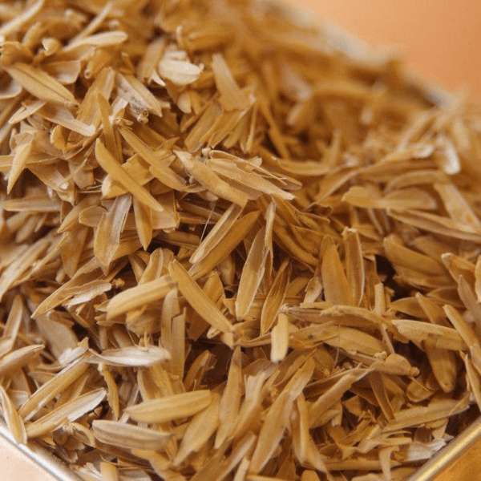
Rice Hulls
Background
Is a normal by-product of rice crops
Is not pH neutral
Is able to drain water well
Will decomposed after some time
Pros
Totally organic
Cons
Break down over time
Not pH neutral

Slide 31
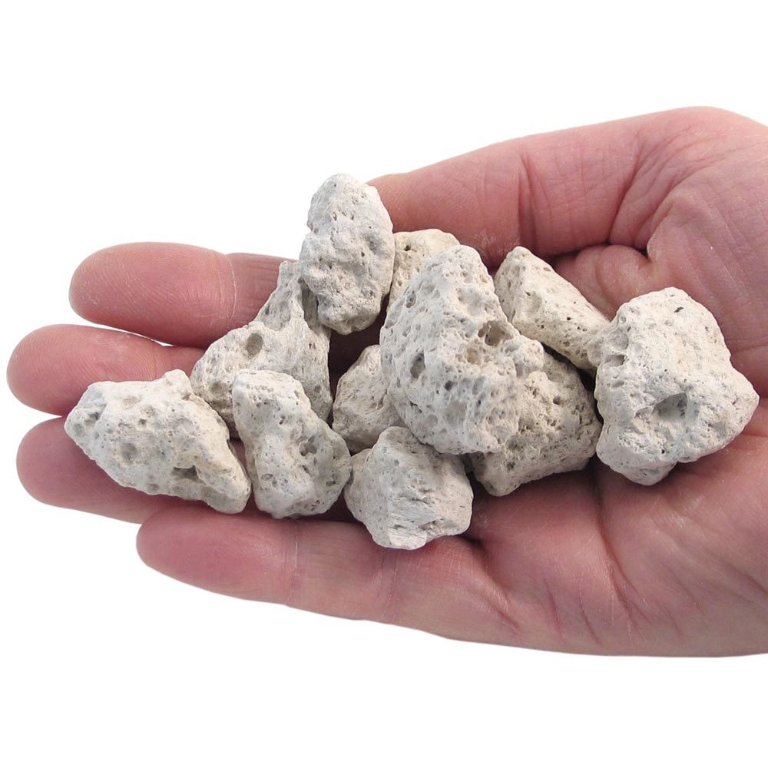
Pumice
Background
Is a mined mineral and formed by a super-heated and highly pressured volcano
Can be white, pale gray or pale yellow
Is lightweight, porous, slow to break down and holds the air well
Tend to float on water
Pros
Lightweight.
Excellent air holding capacity
Cons
Too lightweight for some hydroponic system

Slide 32
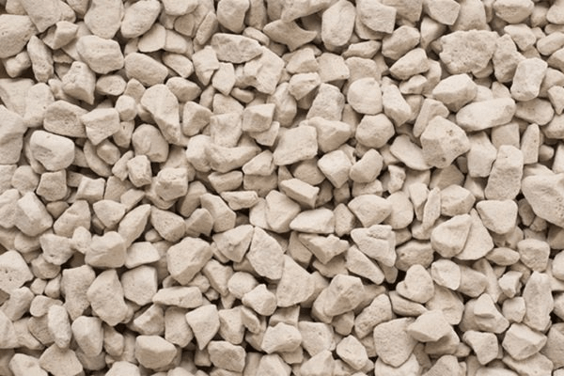
Growstones
Background
Is made from recycled glass from landfills or glass collecting and processing places
Is very lightweight and highly porous
Has great air aeration and average moisture retention
Is ideal for using alone or mix with other growing medium
Pros
Lightweight
Good air to water ratio
Sustainable
Cons
Cling to some roots, which can cause root damage for some plant types
A little bit of dust.
More expensive than other media

Slide 33
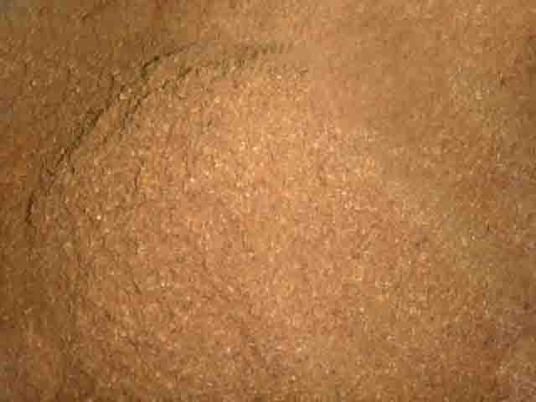
Sawdust
Background
Is a by-product of sawmills and retail hardware stores
Is inexpensive and not pH neutral
Is lightweight and retains water well
Is biodegradable but will decompose over time
Compacts quickly, pH-altering, and can be contaminated
Depends on whether the wood is chemically treated or contaminated, it might not be safe for planting
Has some limited successes in Africa for soilless planting, and for Hydroponic tomato growing in Australia
Pros
Organic
Sustainable
Cons
pH fickle
Rot over time, and can cause bacteria
May not be sterile

Slide 34
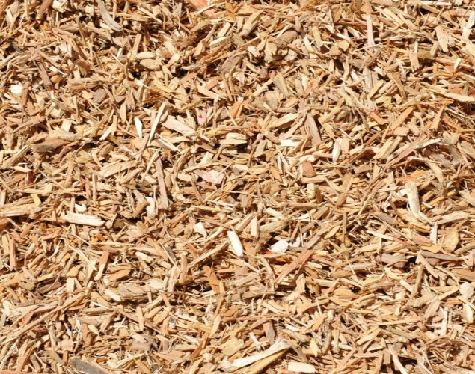
Wood Chips/Fibers
Background
Made from woods
Is totally organic
Needs to make sure that wood chips are not used from contaminated wood, or should be sterilized before using
Holds water well
Is not so compacted and waterlogged as sawdust
Pros
Totally organic
Able to retain water well
Cons
Biodegradable
Can contain chemicals
May bring fungi, pests

Slide 35
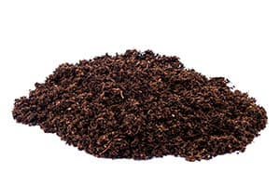
Peat Moss
Background
Is a dead fibrous material that develops in a wet, cold, acidic, and lack-of-air environment called peat bogs. In that environment, sphagnum moss and other living things decompose into a dense dark brown compact.
Is not renewable and not environmentally friendly
Has excellent moisture nutrient retaining, and organic soil-softening durable material
Hold water well
Can be use in Hydroponics
Can get wet then rehydrate quick and does not compact or break down easily
Pros
Good water, and nutrient holding.
Does not compact
Does not comprise of harmful bacteria or weeds
Cons
Not renewable.
Low pH, acidic.
Relatively expensive

Slide 36
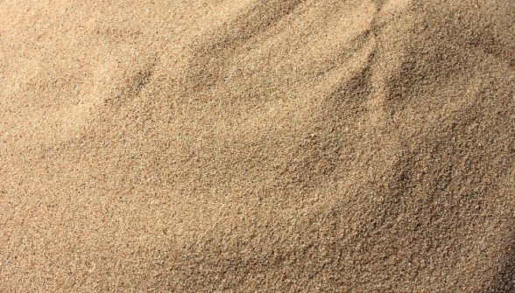
Sand
Background
Is relatively cheap
Is composed of super small finely divided rocks
Has poor aeration qualities, and must usually be cleaned
Pros
Cheap
Cons
Low aeration
The tiny size which can block some system types

Slide 37
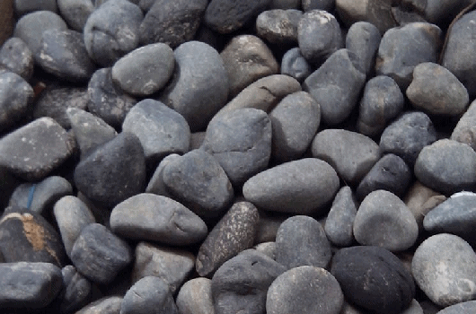
Gravel
Background
Has been implemented with hydroponic and has great success
Does not hold water well
Is durable and can be reusable
Pros
Cheap
Cons
Poor water retention, not suitable for heavy plant roots.
Heavy

Slide 38
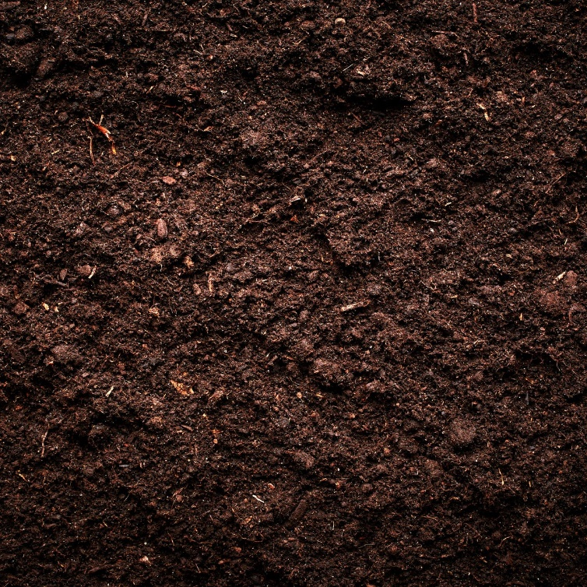
Soil
Background
Is natural and abundant
Easy to use
Success Proven
Can damage the plants if overfeed
Pros
Natural environment
Lower costs
Naturally adjusts itself
Cons
Longer/slower growing cycle
Pests
Can be dirty if wet

